Slide 1
DVWA 建置

Slide 2
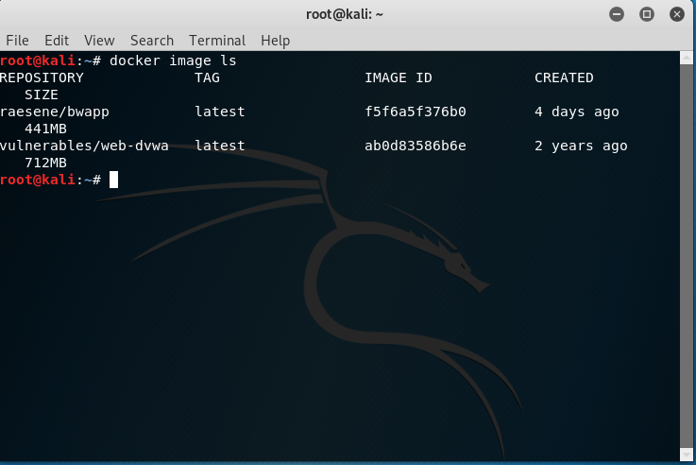
Docker image ls

Slide 3
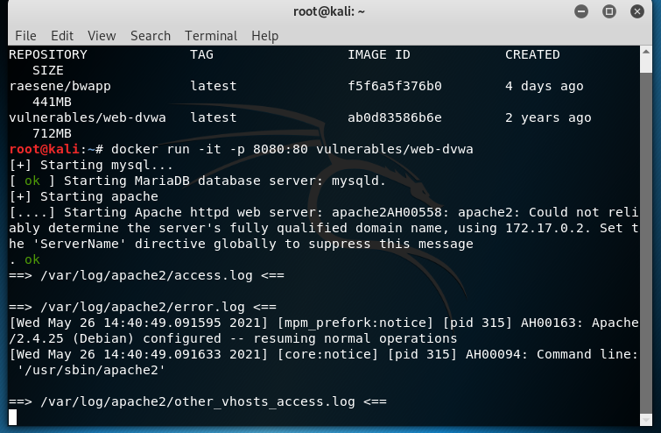
Docker run –it –p 8080:80 vulnerables/web-dvwa

Slide 4
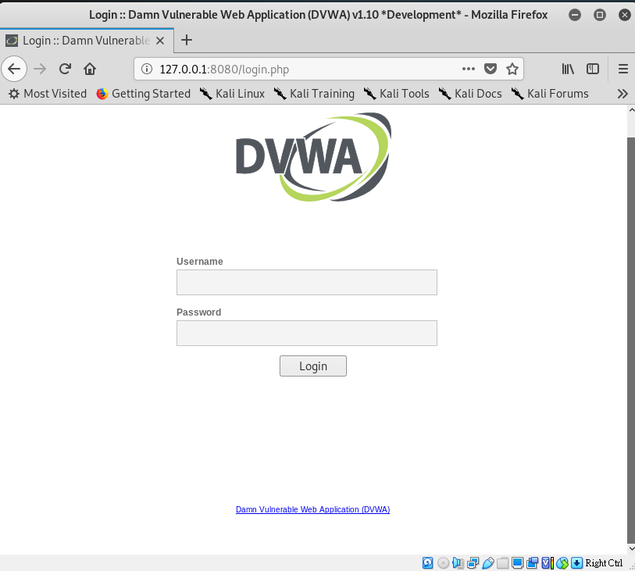
http://127.0.0.1:8080/login.php

Slide 5
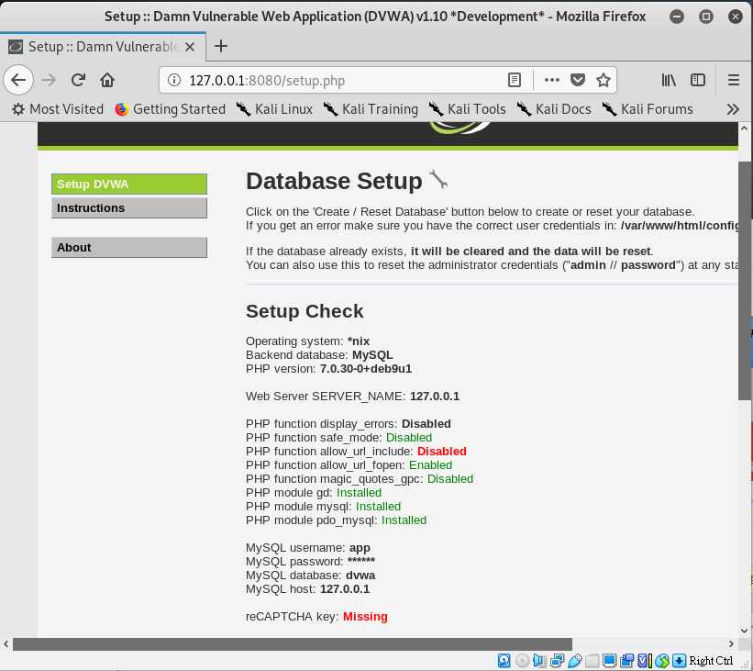
Admin/password

Slide 6
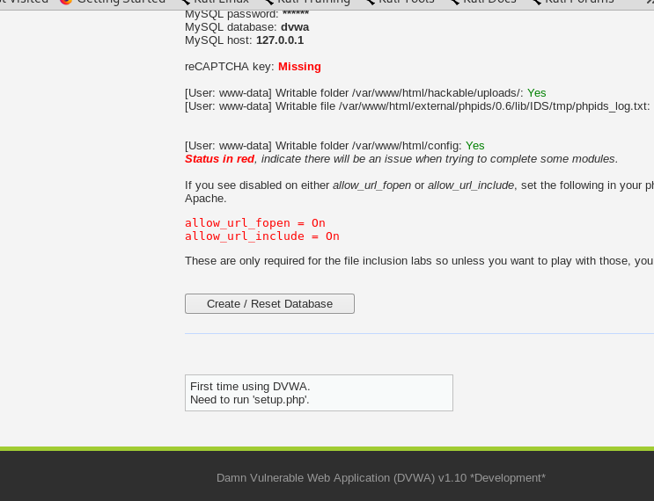


Slide 7
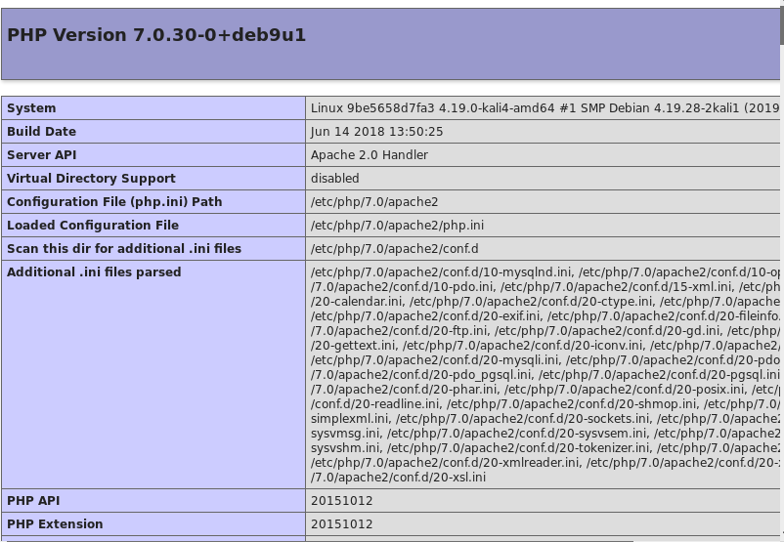

Slide 8
